Slide 1

Quant Week 4
2/15/24
Notes:
Complete

Slide 2

Agenda
Icebreaker Question
Brainteasers
Shorting
Margin
Options
Project

Slide 3
Ice Breaker
Favorite holiday

Slide 4
Brain Teaser - Roulette
You and a friend are playing russian roulette with a toy revolver.
A (toy) bullet is put into a (toy) revolver with 6 chambers, the bullet is equally likely to be in any hole. The barrel is randomly spun ONCE.
If you get the bullet you lose
Would you rather go first or second?

Slide 5
Brain Teaser - Roulette Part 2
Would you rather go first or second?
First Player: 1st, 3rd, or 5th spin.
First Player: 1/6 + 5/6*4/5*1/4 + 5/6*4/5*3/4*2/3*1/2=0.5
Second Player: 2nd, 4th, or 5th spin
Second Player: 5/6*1/5 + 5/6*4/5*3/4*1/3 + 5/6*4/5*3/4*2/3*1/2*1 =0.5
Equal probabilities. Intuition: The bullet is either in slot 1,2, or 3, or 2, 4, or 6 so it’s fixed from the beginning
What if we spin the barrel after every shot?

Slide 6
Brain Teaser - Roulette Part 2
What if we spin the barrel after every shot?
Now every shot has 1/6 probability
The probability that you lose at all is p, so the probability your opponent loses is 1-p
p=1*1/6 + (1-p)*5/6
p = 6/11
This means that you should go second, your odds of losing are 5/11

Slide 7
Brain Teaser - Roulette Part 3
You now have 2 bullets, you have the option to spin the barrel if you want. Should you spin the barrel?
If you spin, the probability of losing is 2/6
If you don’t spin the probability of losing is ⅖
So yes, spin the barrel

Slide 8
Brain Teaser - Roulette Part 4
There are still 2 bullets, but they’re in consecutive positions now. If your opponent survives the first round should you spin the barrel?
Lets say the bullets are in positions 5 and 6
This means if your opponent survives, he either hit 1, 2, 3, or 4.
This means you will hit either 2, 3, 4, or 5, so you will have a 1 in 4 chance
If you spin, the probability of losing is still 2/6
If you don’t spin the probability of losing is 1/4
So no, don’t spin the barrel

Slide 9
Shorting

Slide 10
Betting Against an Asset
Suppose AAPL is trading at $100, and you believe that it’s true value is closer to $150. Given that assets tend towards their true value, a way you could profit off of this belief is just buying AAPL. If your belief is accurate, you will eventually gain $50 per share that you purchase.
Now suppose AAPL is trading at $100, but you believe that it should be valued at $50. There is clearly a price discrepancy between AAPL and your opinion of it’s true value, so you should be able to profit off of this.
One way might be to find an asset that has negative correlation with AAPL’s stock price, and buy that. Another way is to short AAPL.

Slide 11
What is Shorting?
A short is a trade in which several things occur
A trader borrows some asset (shares of stock, bonds, options, etc.)
The trader than sells that asset
After some time, the trader buys back that asset
The trader returns the asset to its original owner
Example: AAPL trades at $100, you think it’s worth $50. You short a share of AAPL, and wait. The price then drops to $50, you close out your position (buy back a share) and walk away $50 richer

Slide 12
Downsides
Buying (longing) a stock and shorting are inverse actions
Buying has limited downside
Most assets can only go down to $0
Shorting has unlimited downside
The price of any given asset can be arbitrarily high
Additional downsides to shorting
Usually you must pay a premium to whomever you are borrowing from, especially for larger orders
Owning a share of stock entitles you to a portion of the company, and (theoretically) a portion of the profits

Slide 13
Margin

Slide 14
Buying on the margin
Buying 1000 shares at $40
You have $20k, so you must borrow the rest.
Your margin is equity/stock value, this situation is 50% margin, or also 2x leverage
Assets
Liabilities + Equity
$40,000 (1000*$40)
$20,000 Loan
$20,000 Equity

Slide 15
Buying on the margin
Price goes to $50
Margin of equity to assets has dropped to 0.33
Usually a minimum margin exists. If it’s hit, you will be forced to sell
Assets
Liabilities + Equity
$50,000 (1000*$50)
$20,000 Loan
$30,000 Equity
Price rise of 25% leads to a 50% gain

Slide 16
Buying on the margin
Price drops to $30 (bad)
Margin of equity to assets has dropped to 0.33
Usually a minimum margin exists. If it’s hit, you will be forced to sell
Assets
Liabilities + Equity
$30,000 (1000*$30)
$20,000 Loan
$10,000 Equity
Price drop of 25% leads to a 50% loss

Slide 17
Short Selling
Shorting 1000 shares at $40
Assets
Liabilities + Equity
$40,000 (unchanging, sale already happened)
$20,000 (initial deposit)
$40,000 Loan (1000*$40)
$20,000 Equity

Slide 18
Short Selling
Price falls to $30
Assets
Liabilities + Equity
$40,000 (unchanging, sale already happened)
$20,000 (initial deposit)
$30,000 Loan (1000*$30)
$30,000 Equity

Slide 19
Options

Slide 20
What are Options?
Options are contracts that give the owner the right to buy or sell an asset at a given price. Similar to shorting, there are several instances in which the ability to trade these contracts might be incredibly useful.
For example, suppose you own a large chunk of Walmart, and there is an earnings call coming up. If you are worried about the result of this earnings call, you might buy options that give you the right to sell Walmart at a little bit below the current price in case the stock price drops significantly.
In this case, options are essentially acting as insurance.

Slide 21
Types of Options
The two primary types of options are call options (“calls), and put options (“puts”).
Calls:
Gives the holder the right to buy an asset at a given price
Generally used when an investor has positive sentiment regarding an asset
Puts:
Gives the holder the right to sell an asset at a given price
Generally used when an investor has negative sentiment regarding an asset

Slide 22
Option Characteristics
There are several characteristics of an option that are important to note:
Price: the price of the actual option contract
Strike Price: the price that the trade would executed at
Expiry Date: the last date at which the option can be exercised
Note that American options can be executed at any time before or on the expiry date, while European options can only be exercised on the expiry date
An important quality to note is that any single options contract is for 100 shares of the underlying stock, but the price and strike price are listed in per share numbers. For example, if an investor buys a call option on AAPL at a $150 strike price, and then exercises it, they will have to pay $15,000. Additionally, if the price of the contract itself is listed at $5.00, the investor will have had to pay $500 for the option.

Slide 23
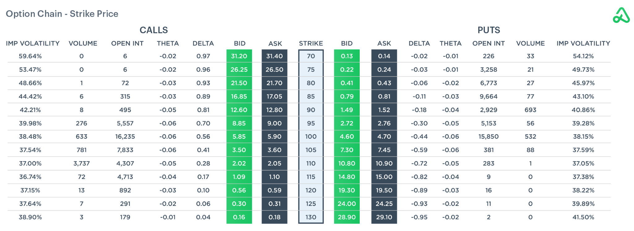
Option Chain

Slide 24
In the Money vs Out of the Money
When looking at a particular set of options, we can divide them into those that are In The Money (ITM) and those that are Out of the Money (OTM). These indicate whether or not the stock has inherent value right now.
ITM calls are calls that have strikes below the current price of the asset. If we have an ITM call, say for example, a $100 strike call on AAPL while it’s trading at $125, we can execute immediately and make profit. Similarly, ITM puts are puts that have strikes above the current price.
OTM calls have strikes above the current price of the asset, and would result in lost money if executed. Similarly, OTM puts have strikes below the current price.

Slide 25
Greek Values

Slide 26
What are the Greeks?
The Greek values are metrics that are used to determine the performance of options in relation to their underlying asset.
These are the first partial derivatives of various factors influencing the asset value.
The primary greek values are:
Delta Δ, Theta Θ, Gamma Γ, Vega v, and Rho ⍴
Note: Beta is not included here.

Slide 27
Greek Values
Delta Δ
Theta Θ
Gamma Γ
Vega v
Rho ⍴
Note: Beta is not included here.

Slide 28
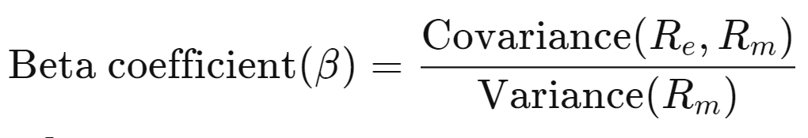
Beta β (not a Greek)
Even though Beta is a greek letter, it is not considered a greek.
It doesn’t represent a partial derivative of the underlying asset like the other values do.
Beta represents the volatility of an asset compared to the rest of the market.
In terms of statistics, this is very similar to variance but is normalized to the market as a whole
A beta of greater than 1 means the asset is more volatile than the market
A beta of less than 1 means the asset is less volatile than the market

Slide 29
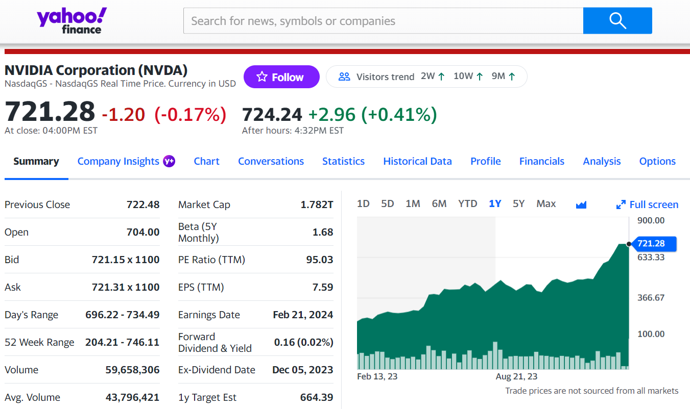
Look at NVDA’s Beta
Beta is 1.68
Means that NVDA is more
volatile than the market, about
1.68x more volatile

Slide 30
Delta Δ
Estimates the change in price of the derivative/option based on a $1 move in the price of the underlying asset
This value is typically not above 1.0
Example,
A stock price increases by $2.
A call option with a strike price of $80 that is currently trading at $20 has a delta of 0.8 What will the new price of this be?
$21.60

Slide 32
Theta Θ
Estimates the rate of change between price and time
Value will get larger as the option gets closer to date of expiration
In-the-money options will have a positive theta value, out of the money options will be negative
Example,
A theta value is -0.5
This means that for every day that passes, the price of the option will go down by $0.50

Slide 33
Last 3 values next week…

Slide 34
Gamma Γ

Slide 35
Vega v

Slide 36
Rho ⍴

Slide 37
Other Lesser Known Greeks
Lambda, Epsilon, Vomma, Vera, Zomma, and Ultima
These are second and third derivatives of the other greeks we have talked about
These trends can also be seen by those with a keen eye by looking at the main Greeks, but are explicitly calculated and named to be these variables
Becoming increasingly more important in large algorithms because they are relatively easy to compute and can show hidden patterns

Slide 38
Buying on the margin
Buying 1000 shares at $40
You have $20k, so you must borrow the rest.
Your margin is equity/stock value, this situation is 50% margin, or also 2x leverage
Assets
Liabilities + Equity
$40,000 (1000*$40)
$20,000 Loan
$20,000 Equity

Slide 39
Buying on the margin
Price goes to $50
Margin of equity to assets has dropped to 0.33
Usually a minimum margin exists. If it’s hit, you will be forced to sell
Assets
Liabilities + Equity
$50,000 (1000*$50)
$20,000 Loan
$30,000 Equity
Price rise of 25% leads to a 50% gain

Slide 40
Buying on the margin
Price drops to $30 (bad)
Margin of equity to assets has dropped to 0.33
Usually a minimum margin exists. If it’s hit, you will be forced to sell
Assets
Liabilities + Equity
$30,000 (1000*$30)
$20,000 Loan
$10,000 Equity
Price drop of 25% leads to a 50% loss

Slide 41
Short Selling
Shorting 1000 shares at $40
Assets
Liabilities + Equity
$40,000 (unchanging, sale already happened)
$20,000 (initial deposit)
$40,000 Loan (1000*$40)
$20,000 Equity

Slide 42
Short Selling
Price falls to $30
Assets
Liabilities + Equity
$40,000 (unchanging, sale already happened)
$20,000 (initial deposit)
$30,000 Loan (1000*$30)
$30,000 Equity

Slide 43
Project Discussion/Work Time
Notes:
Idea:
We’ll write the platform to make and conduct trading strategies.
You guys will write and implement the strategies, test them on prior data
Alternate for more software-oriented people you guys could also make the platform
We can do this in python/C++, if python use numPy and Yahoo Finance data
Use matplotlib plot graphs, show that in pdf/md/html file through github

Slide 44
Example program
Everything you should need to install:
import yfinance as yf
print("Hello")
ticker_symbol = "AAPL"
start_date = "2020-01-01"
end_date = "2024-01-01"
ticker = yf.Ticker(ticker_symbol)
historical_data = ticker.history(start=start_date, end=end_date)
print("Historical Prices for ", ticker_symbol)
print(historical_data)
conda install –c conda-forge yfinance
conda install pandas
conda install numpy
conda install matplotlib
You can also try adding data that’s always current
from datetime import datetime
end_date = datetime.now().strftime('%Y-%m-%d')
historical_data = ticker.history(start='2020-01-01',end=end_date)

Slide 45
Adding a graph
import pandas as pd
import matplotlib.pyplot as plt
... #code from last slide
df = pd.DataFrame(historical_data)
plt.figure(figsize=(10, 6))
plt.plot(df.index, df['Close'], label='Close Price', color='blue')
plt.title('Historical Stock Price Data for ' + ticker_symbol)
plt.xlabel('Date')
plt.ylabel('Price (USD)')
plt.legend()
plt.grid(True)
plt.show()
import yfinance as yf
print("Hello")
ticker_symbol = "AAPL"
start_date = "2020-01-01"
end_date = "2024-01-01"
ticker = yf.Ticker(ticker_symbol)
historical_data = ticker.history(start=start_date, end=end_date)
print("Historical Prices for ", ticker_symbol)
print(historical_data)

Slide 46
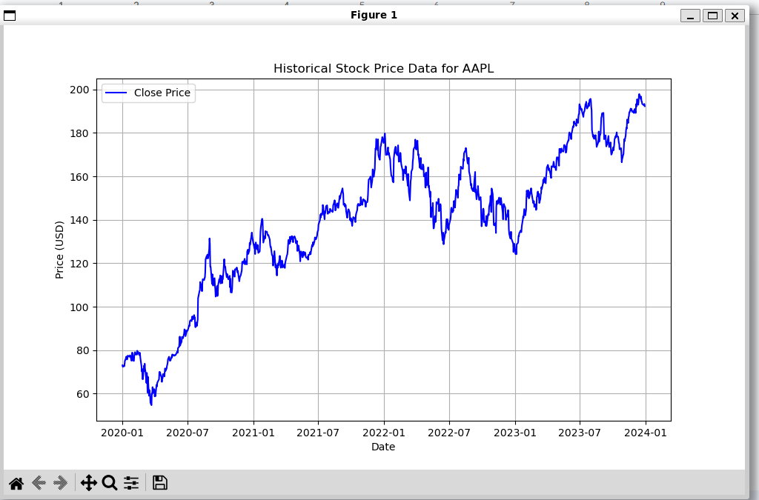
You should get a graph like this

Slide 47
Python Setup - Last time slides
This is what you can type in your terminal to install python
Note: python and python3 are different
python is the default python interpreter, but it may be the wrong version
As long as whichever one you use is version 3 you are good to go
~$ sudo apt install python3
~$ python3 --version
~$ python --version
~$ python3 test.py
~$ python test.py

Slide 48
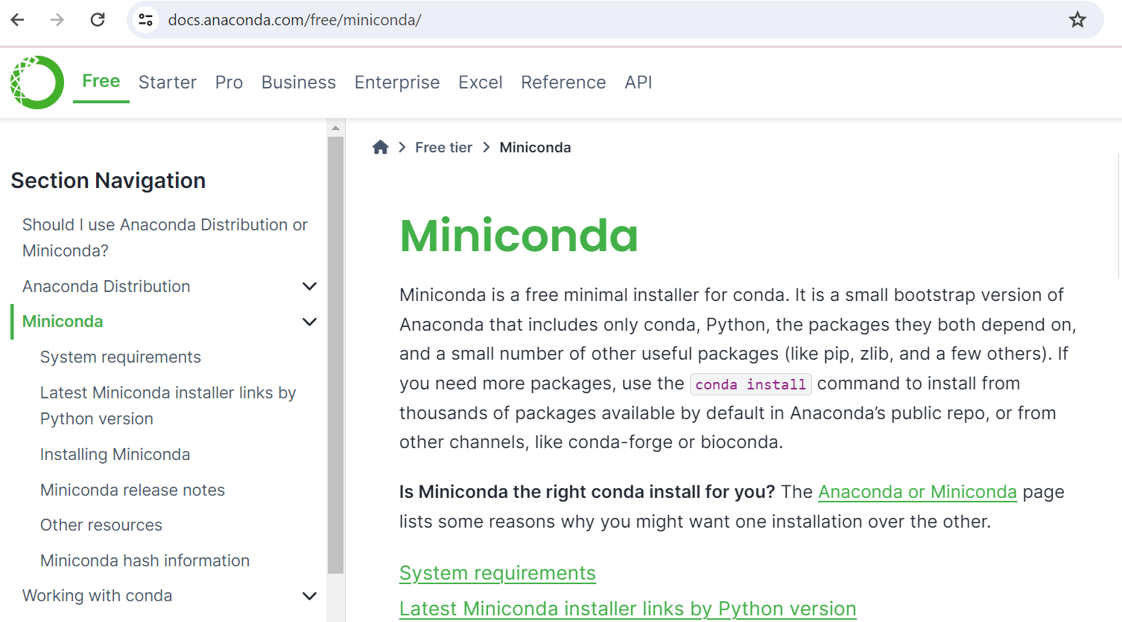
Conda Setup - Last time slides
We are going to use miniconda
Go to this website and download
the version for your system
May need to add execute privilege to the file, then run it
Simple conda commands Create environment in your folder:
replace python=3.7 with your version
Get yfinance package
chmod +x <.sh filename>
conda init
conda list
conda env list
conda install <whatever>
conda create –name <name> python=3.7
conda install –c conda-forge yfinance

Slide 49

Attendance Form
This one
Link to Onboarding Document, Slack and Team Folder
https://docs.google.com/document/d/1oA2q-qjPCw1bY79zWf1LtpeN_da65L0ntnxzCQSsJRc/edit?usp=sharing
https://forms.gle/Up9noY4arbndAj5p7

